Slide 1


Teaching Latin and Making Linguists at Stanley Road

Slide 2
Agenda
Latin and the National Curriculum
Why teach Latin?
Getting started with Classics
Planning the curriculum
Teaching the lessons

Slide 3
Latin and the National Curriculum

Slide 4
Latin in the National Curriculum
‘Teaching may be of any modern or ancient foreign language and should focus on enabling pupils to make substantial progress in one language.’
‘The focus of study in modern languages will be on practical communication. If an ancient language is chosen the focus will be to provide a linguistic foundation for reading comprehension and an appreciation of classical civilisation. Pupils studying ancient languages may take part in simple oral exchanges, while discussion of what they read will be conducted in English. A linguistic foundation in ancient languages may support the study of modern languages at key stage 3.’
Notes:
Not explicitly in KS3 languages national curriculum but pupils can take Latin GCSE

Slide 5
Ancient Languages are taught differently
listen attentively to spoken language and show understanding by joining in and responding
explore the patterns and sounds of language through songs and rhymes and link the spelling, sound and meaning of words
engage in conversations; ask and answer questions; express opinions and respond to those of others; seek clarification and help*
speak in sentences, using familiar vocabulary, phrases and basic language structures
develop accurate pronunciation and intonation so that others understand when they are reading aloud or using familiar words and phrases*
present ideas and information orally to a range of audiences*
read carefully and show understanding of words, phrases and simple writing
appreciate stories, songs, poems and rhymes in the language
broaden their vocabulary and develop their ability to understand new words that are introduced into familiar written material, including through using a dictionary
write phrases from memory, and adapt these to create new sentences, to express ideas clearly
describe people, places, things and actions orally* and in writing
understand basic grammar appropriate to the language being studied, including (where relevant): feminine, masculine and neuter forms and the conjugation of high-frequency verbs; key features and patterns of the language; how to apply these, for instance, to build sentences; and how these differ from or are similar to English.

Slide 6
Ancient Languages are taught differently
listen attentively to spoken language and show understanding by joining in and responding
explore the patterns and sounds of language through songs and rhymes and link the spelling, sound and meaning of words
engage in conversations; ask and answer questions; express opinions and respond to those of others; seek clarification and help*
speak in sentences, using familiar vocabulary, phrases and basic language structures
develop accurate pronunciation and intonation so that others understand when they are reading aloud or using familiar words and phrases*
present ideas and information orally to a range of audiences*
read carefully and show understanding of words, phrases and simple writing
appreciate stories, songs, poems and rhymes in the language
broaden their vocabulary and develop their ability to understand new words that are introduced into familiar written material, including through using a dictionary
write phrases from memory, and adapt these to create new sentences, to express ideas clearly
describe people, places, things and actions orally* and in writing
understand basic grammar appropriate to the language being studied, including (where relevant): feminine, masculine and neuter forms and the conjugation of high-frequency verbs; key features and patterns of the language; how to apply these, for instance, to build sentences; and how these differ from or are similar to English.

Slide 7
Why teach Latin?

Slide 8
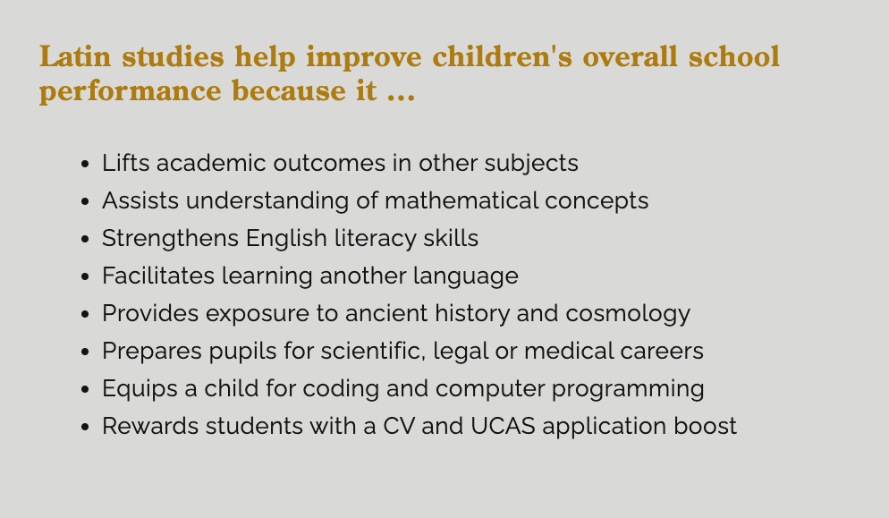
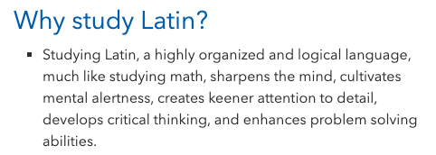

Slide 9


Slide 10
Why Latin? What is the substantive content?
Developing knowledge of how English language evolved over time (and other languages)
Developing knowledge of grammar
Developing knowledge of vocabulary
Developing knowledge of ancient civilisation
Developing knowledge of Latin
We also think it prepares children to learn a range of languages in KS3, in particular, the two most popular languages, French and Spanish
Notes:
Spanish wasn’t working
Our children moved to ks3 and either started again with Spanish or began a new language altogether

Slide 11
Etymology - Using Latin to understand English
Latin word | Meaning | Use in English
laboro
scribo
sonus
donum
Notes:
Can you guess the meaning of these words and what they link to? E.g. equus is a horse, equestrian etc…

Slide 12
Etymology - Using Latin to understand English
Latin word | Meaning | Use in English
laboro
scribo
sonus
donum
Notes:
Can you guess the meaning of these words and what they link to? E.g. equus is a horse, equestrian etc…

Slide 13
Etymology - Using Latin to develop vocabulary
Latin word | Meaning | Use in English
laboro | to work | labour, laborious, laboratory, elaborate, collaborate
scribo
sonus
donum
Notes:
Can you guess the meaning of these words and what they link to? E.g. equus is a horse, equestrian etc…

Slide 14
Etymology - Using Latin to develop vocabulary
Latin word | Meaning | Use in English
laboro | to work | labour, laborious, laboratory, elaborate, collaborate
scribo | to write | scribe, describe, inscribe, scribble, script, nondescript
sonus
donum
Notes:
Can you guess the meaning of these words and what they link to? E.g. equus is a horse, equestrian etc…

Slide 15
Etymology - Using Latin to develop vocabulary
Latin word | Meaning | Use in English
laboro | to work | labour, laborious, laboratory, elaborate, collaborate
scribo | to write | scribe, describe, inscribe, scribble, script, nondescript
sonus | noise | sound, sonorous, sonic, sonnet, song, sonata
donum
Notes:
Can you guess the meaning of these words and what they link to? E.g. equus is a horse, equestrian etc…

Slide 16
Etymology - Using Latin to develop vocabulary
Latin word | Meaning | Use in English
laboro | to work | labour, laborious, laboratory, elaborate, collaborate
scribo | to write | scribe, describe, inscribe, scribble, script, nondescript
sonus | noise | sound, sonorous, sonic, sonnet, song, sonata
donum | gift | donate, donation, donor
Notes:
Can you guess the meaning of these words and what they link to? E.g. equus is a horse, equestrian etc…

Slide 17
Is Latin only for the elite?

Slide 18
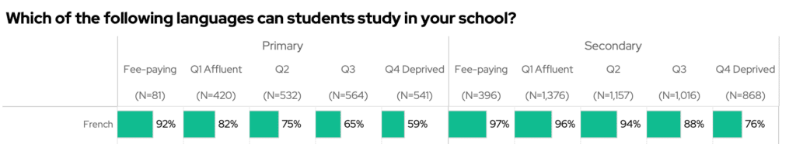
Notes:
46% of fee paying primary schools teach Latin
3% of non-fee paying primary schools teach Latin

Slide 19
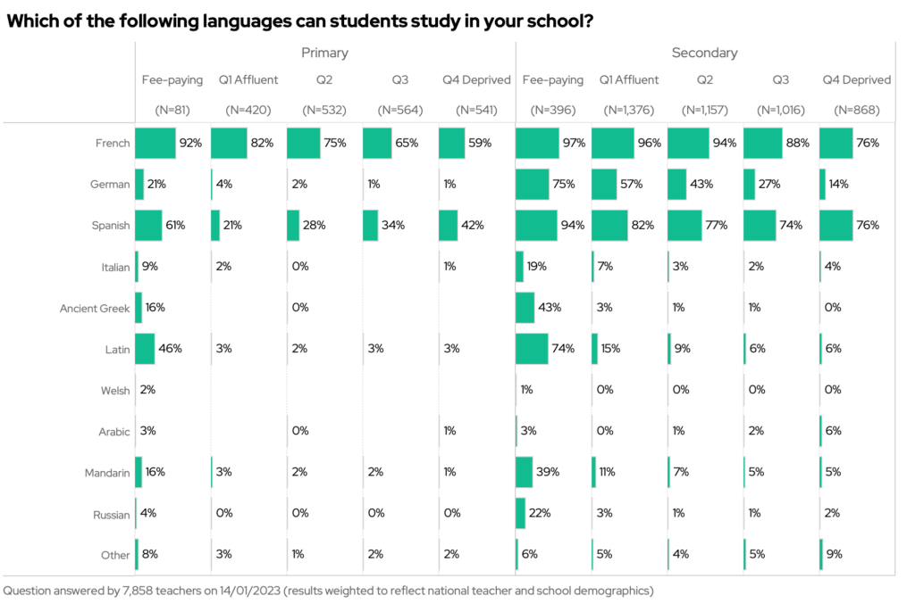
Notes:
46% of fee paying primary schools teach Latin
3% of non-fee paying primary schools teach Latin

Slide 20
Notes:
46% of fee paying primary schools teach Latin
3% of non-fee paying primary schools teach Latin

Slide 21


Slide 22
Getting Started with Classics

Slide 23

Getting started
https://classicsforall.org.uk/my-school-wants-classics/apply-support
Notes:
Once we made the decision, we contacted CfA, they provided training, textbooks, taster sessions, networking,

Slide 24
Planning the Curriculum

Slide 25
When do we teach Latin?
Years 5 & 6: 1 hour per week
Grammar
Swimming/music
Focus on reading
How does Latin link to our wider curriculum?
Review ‘Romans’ from Y3
Etymology in spellings
Etymology in other curriculum areas
Myths and stories

Slide 26
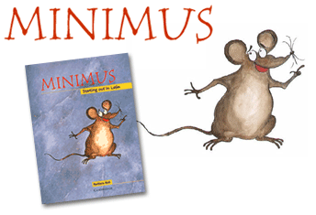
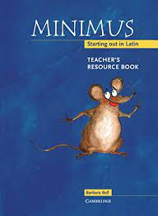
What resources do we use?

Slide 27
What resources do we use?
12 chapters in the book
1 chapter per half term
6 lessons per chapter
Story and characters continue throughout the book
Grammar and vocabulary are repeated throughout

Slide 28
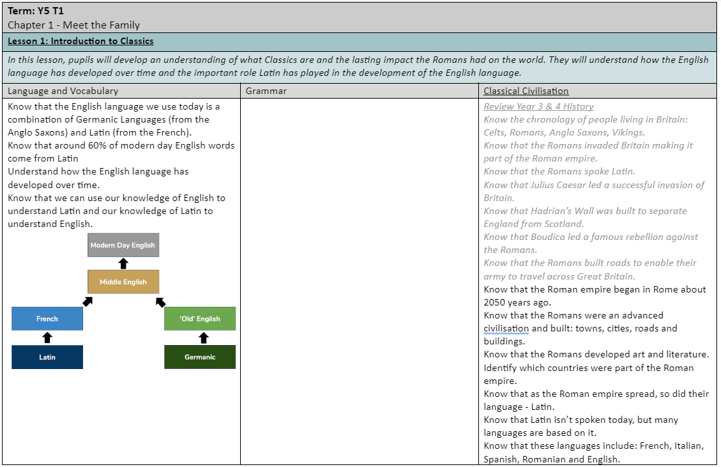
Minimus underpins our curriculum

Slide 29
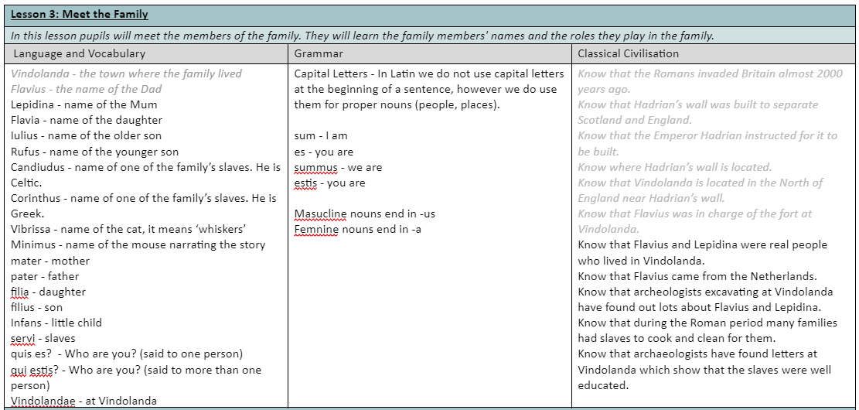
Minimus underpins our curriculum

Slide 30
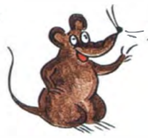

Teaching the Lessons
small
mouse

Slide 31
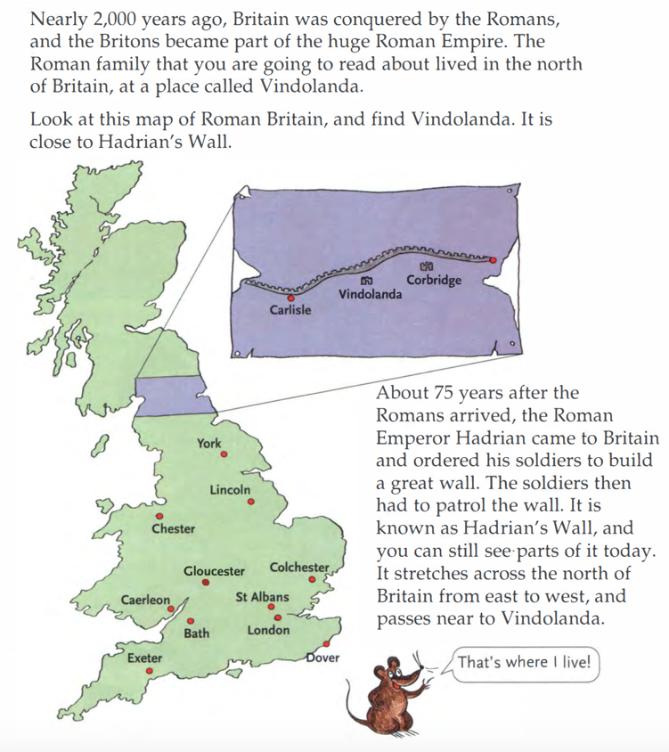
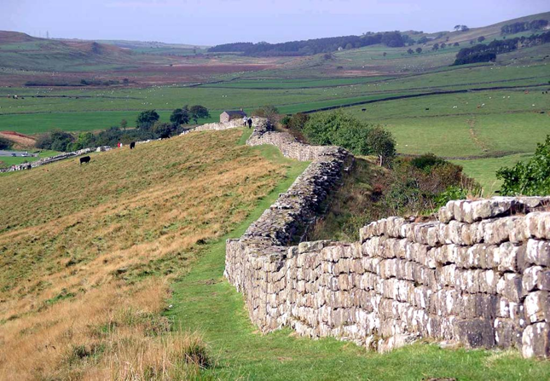
Minimus: The Story

Slide 32

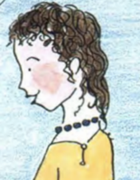
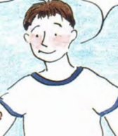
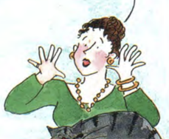
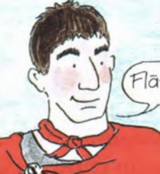
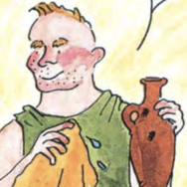
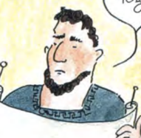
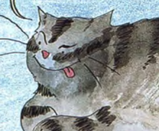
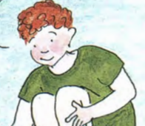
Minimus: The Family
Minimus
Lepidina
Flavius
Flavia
Iulius
Rufus
Candidus
Corinthus
Vibrissa

Slide 33
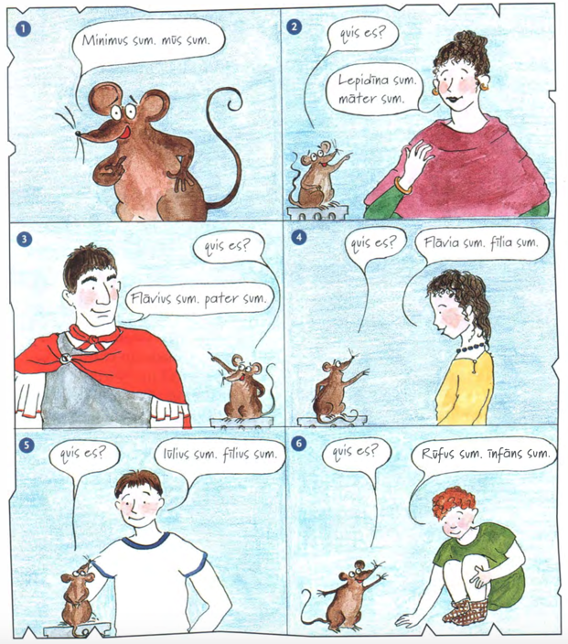
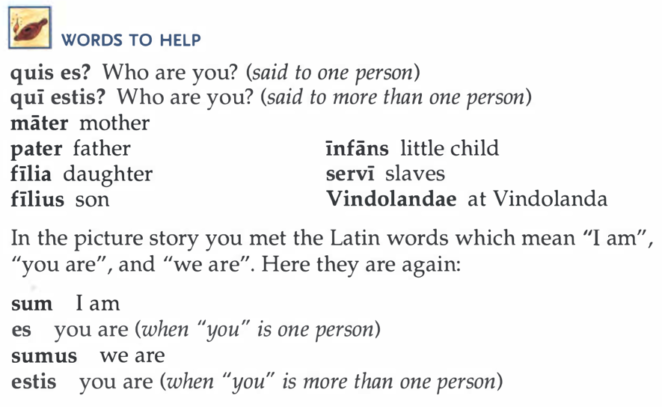
Minimus: Learning the Language

Slide 34
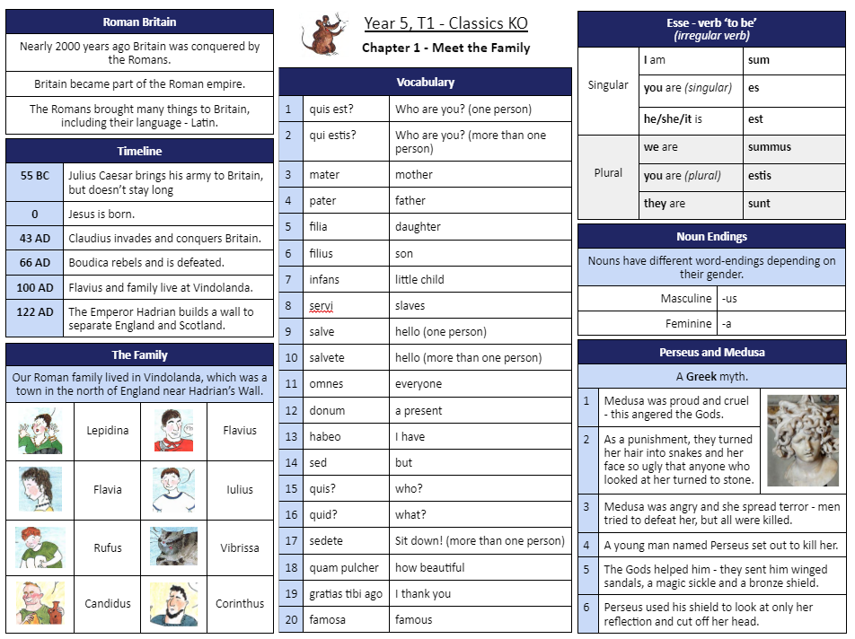
Minimus: Knowledge Organiser

Slide 35
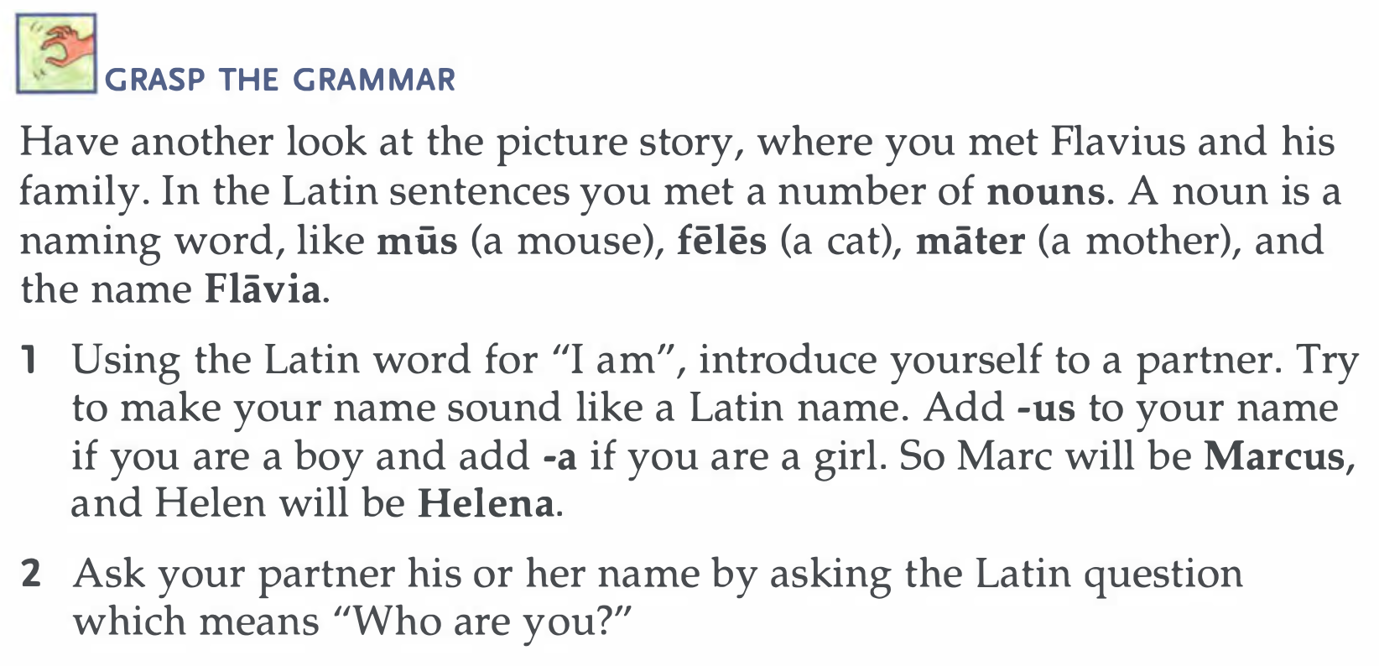
Minimus: Grammar

Slide 36
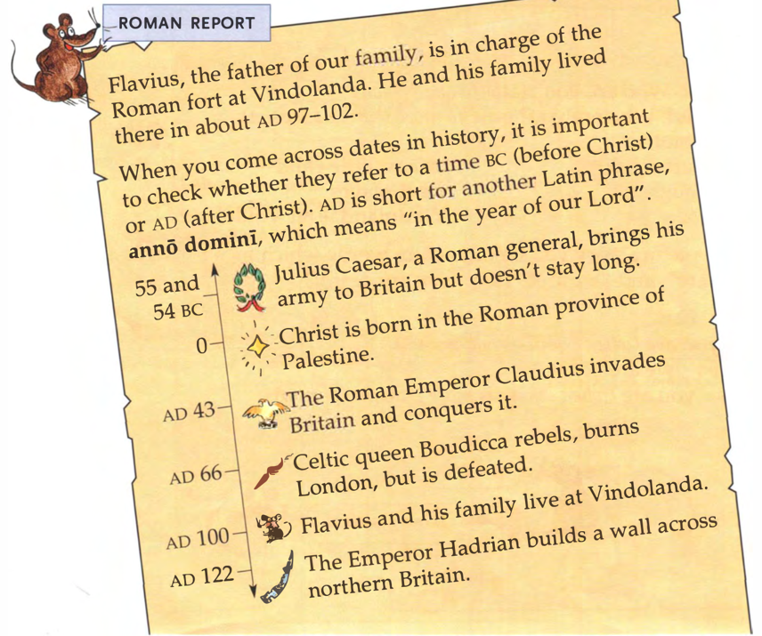
Minimus: Classical Civilisation

Slide 37
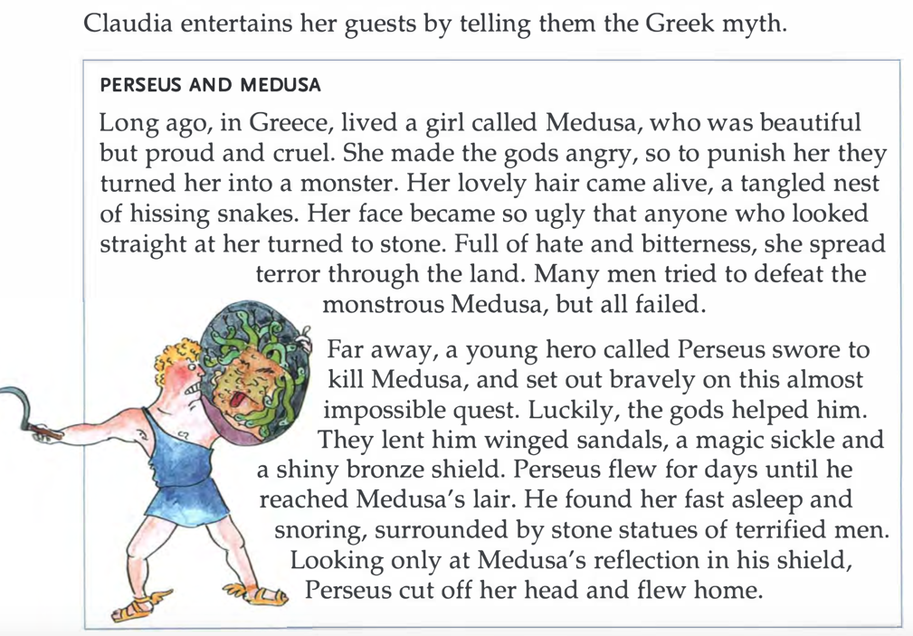
Minimus: Myths
Greek
Roman
Briton

Slide 38
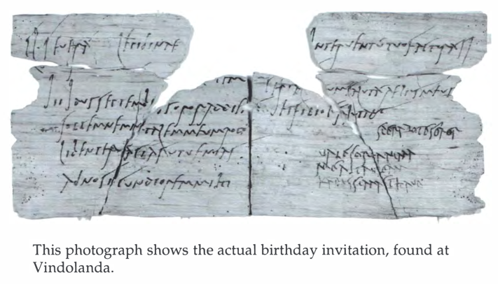
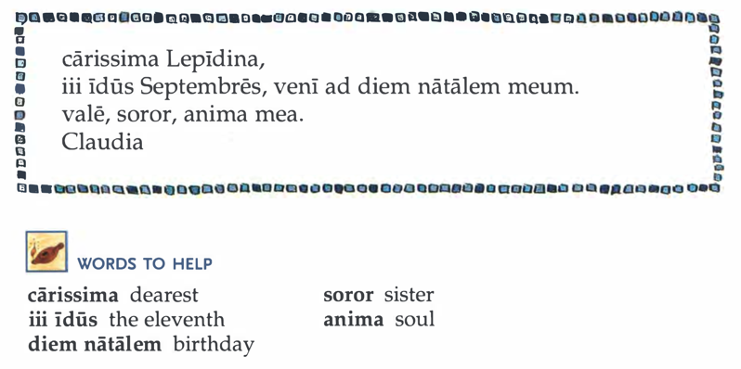
Minimus: Disciplinary Knowledge

Slide 39
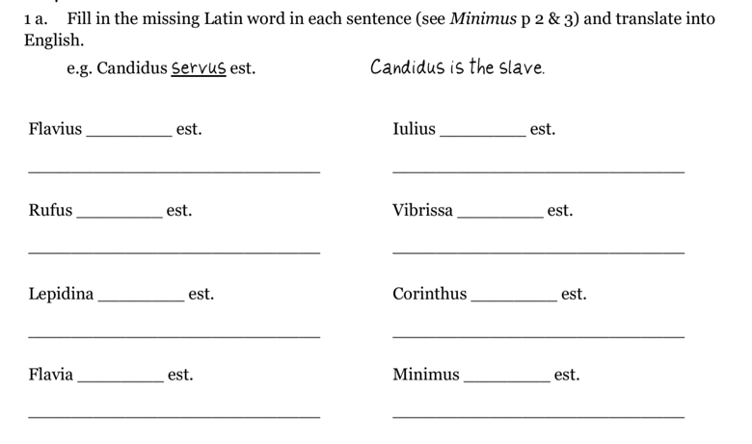
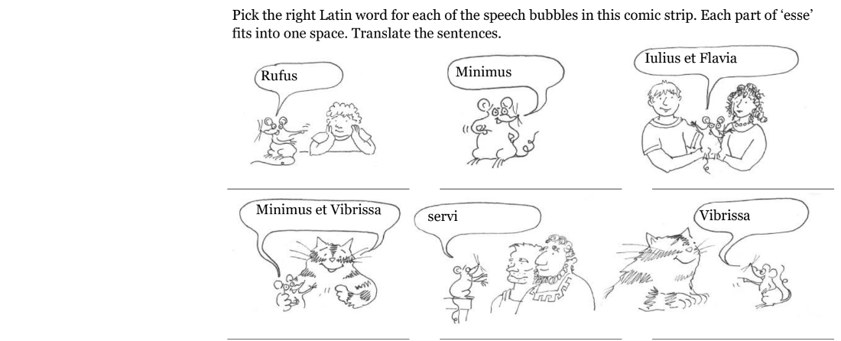
Minimus: Teacher Resource Book

Slide 40
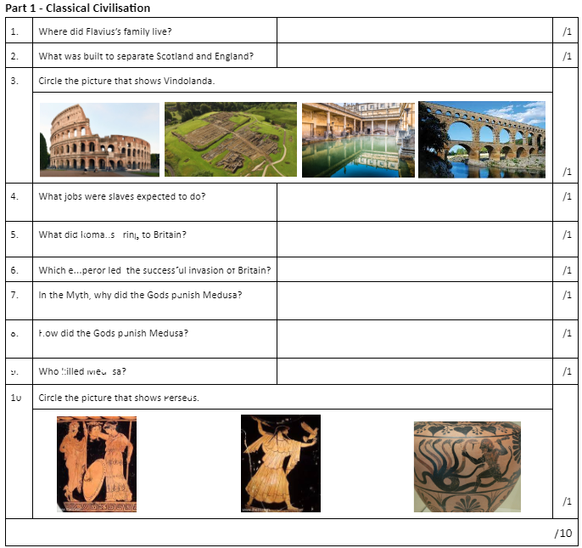
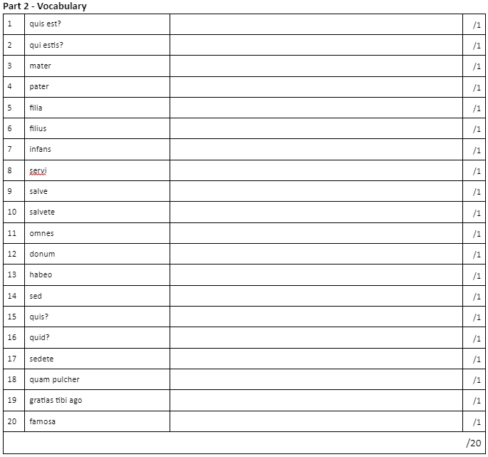
Minimus: Assessment

Slide 41
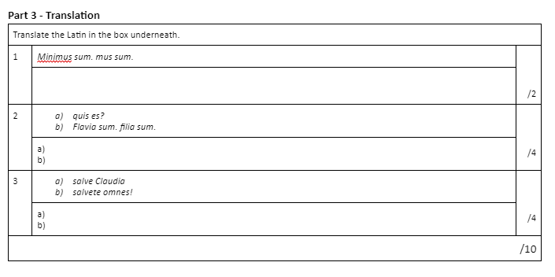
Minimus: Assessment

